Slide 1
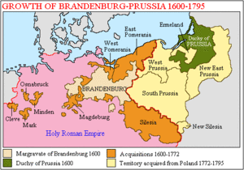
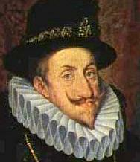
Section 4
The Rise of Austria and Prussia

Slide 2
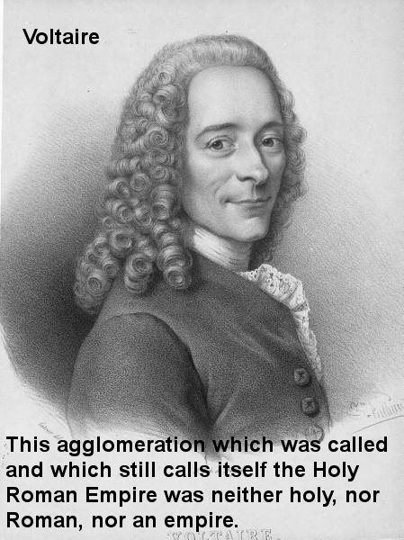
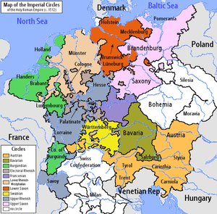
The German States do not become an absolute state…
By Early Modern Times – French Philosopher Voltaire observed:
The Holy Roman Empire was neither
holy, nor Roman, nor an Empire
It was a patchwork of several hundred small, separate states
Holy Roman Emperor had little power over German Princes called electors.

Slide 3
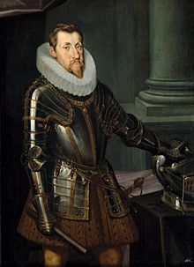
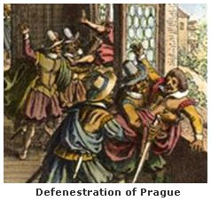
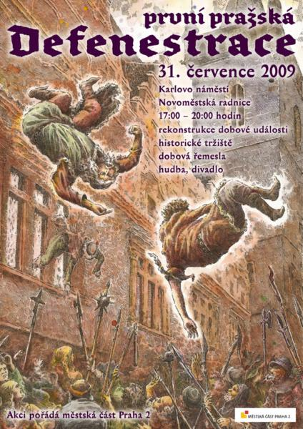
The Thirty Years’ War Ravages Europe
Actually a series of wars
Began in Bohemia
Ferdinand, Catholic Hapsburg King of Bohemia
Sought to suppress Protestants & assert royal power over nobles
Became Holy Roman Emperor
With Spain & Poland tried to reverse Reformation
Defenestration of Prague - May 1618: rebellious Protestant Noblemen toss two royal officials out of a castle window – sparked a general revolt

Slide 4
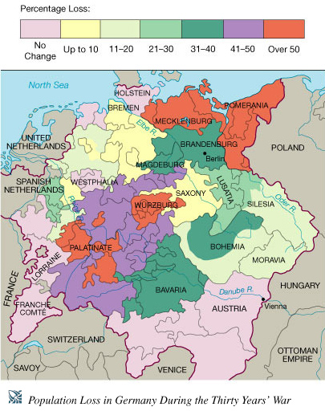
30 YEARS WAR had religious and political causes
North was Protestant, South was Catholic
A BRUTAL CONFLICT.
Roving paid Armies (Mercenaries) Burned villages and destroyed crops
KILLED up to one third of the entire population
Severe depopulation >>

Slide 5
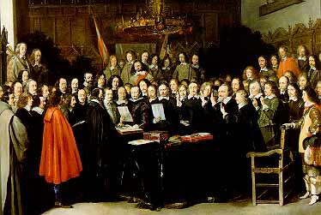
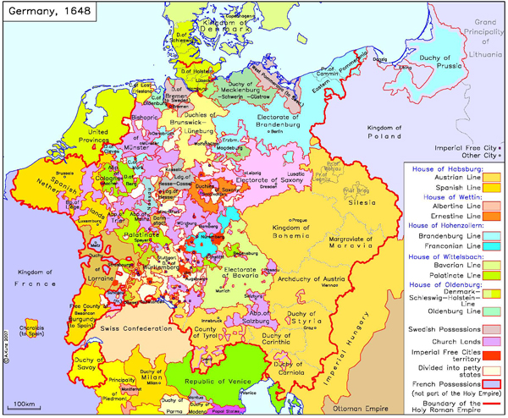
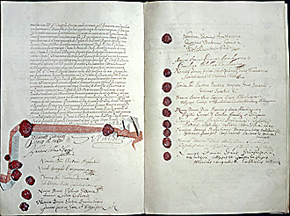
War ended in 1648 with the TREATY OF WESTPHALIA aka the Peace of Westphalia
Divided Germany into more than 360 separate states, “one for each day of the year” -
Germany remains fragmented for another 223 years

Slide 6
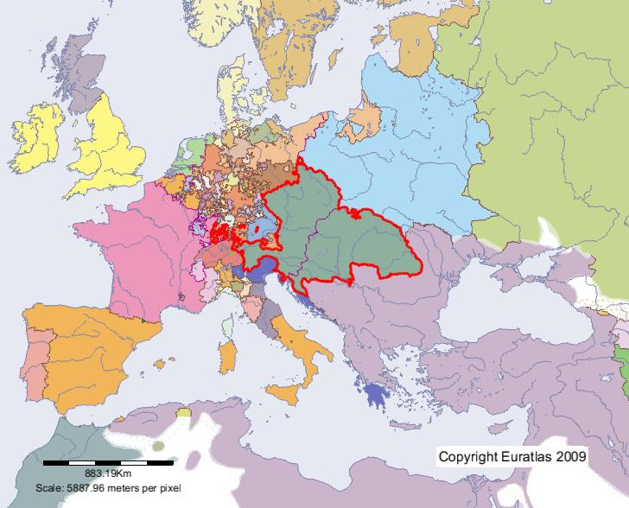
Hapsburg (Habsburg) Austria Changes its Focus
By the 1700s the Hapsburg Empire included:
Austria
Bohemia
Hungary
Parts of Poland
Some Italian city states
Diverse peoples
Slavs
Magyars
Germans & more
Different languages
Different customs
Different laws
Habsburg Empire in 1700
Difficult to control so many diverse peoples – never developed a centralized government

Slide 7
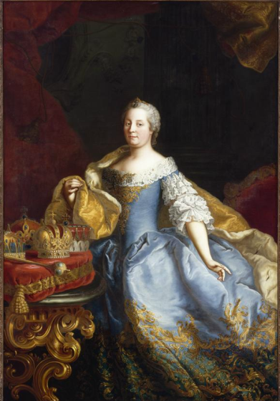
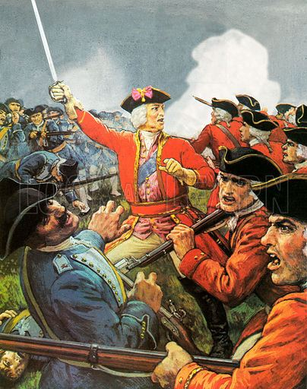
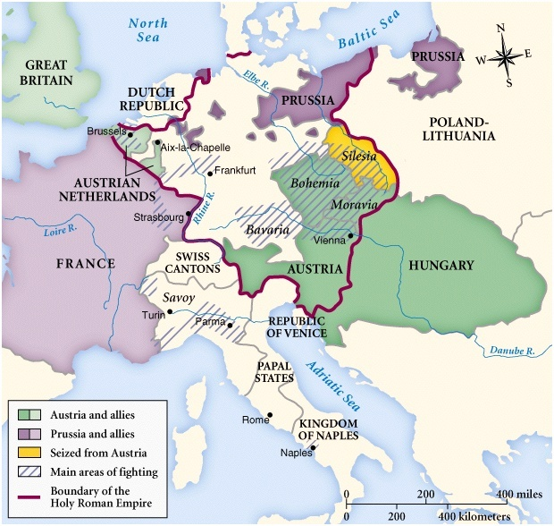
Maria Theresa and The War of Austrian Succession
Emperor Charles VI dies
- No son
Daughter Maria Theresa takes throne
Prussia takes province of Silesa – sparks War of the Austrian Succession
Maria gets help from Hungary, Britain & Russia
She keeps kingdom together
Reorganized the government
Improved tax collection
Made nobles & clergy pay taxes and peasant s paid less

Slide 8
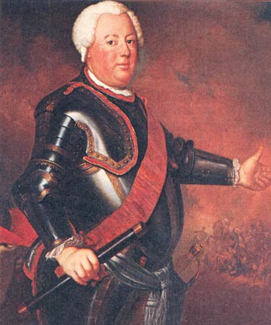
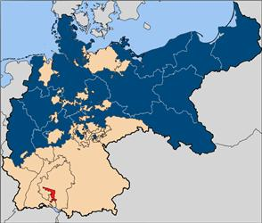
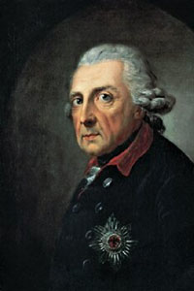
Hohenzollern Prussia
Efficient central bureaucracy
Frederick William I gives nobles positions in government – strengthened his power
Best trained army in Europe
Frederick II (a.k.a. Frederick the Great) –
Seized Silesia from Austria (War of Austrian Succession)
all of Europe recognized the great power of Prussia
1600s – Hohenzollern rulers united holdings in North Germany – created Prussia

Slide 9
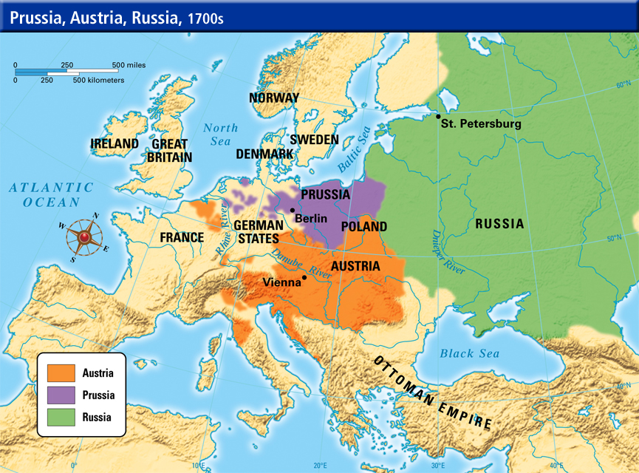
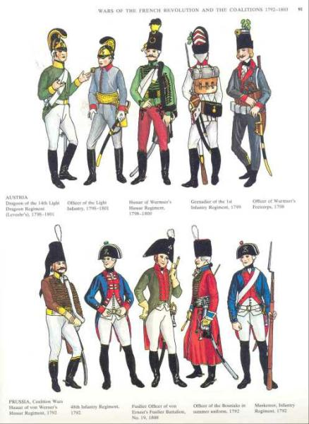
The Rivalry of Great Powers
1750 – Great European Powers are:
Austria
Prussia
France
Britain
Russia
Various alliances = balance of power
Rivalries:
Prussia battled Austria
Britain battled France

Slide 10
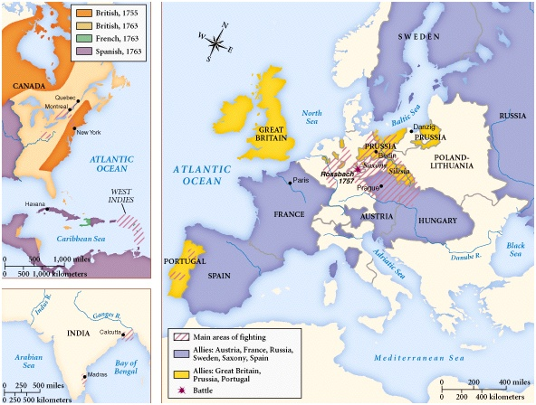
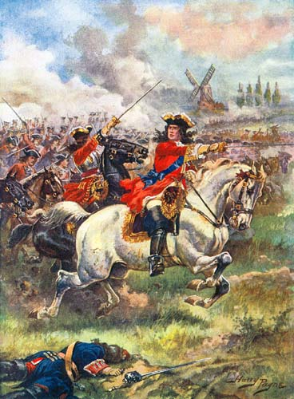
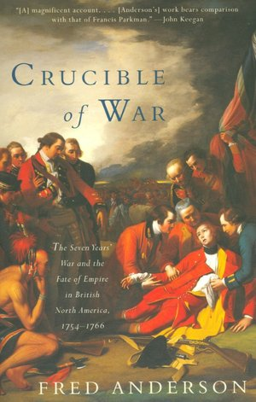
Seven Years’ War 1756 – 1763:
On four continents
Prussia, Austria, Russia, France & Britain battled in Europe
Britain & France also fought in India & Africa
In North America France battled England – Native Americans joined both sides (a.k.a. The French & Indian War)
Treaty of Paris gave Britain huge empire – changed balance of power

